Slide 1
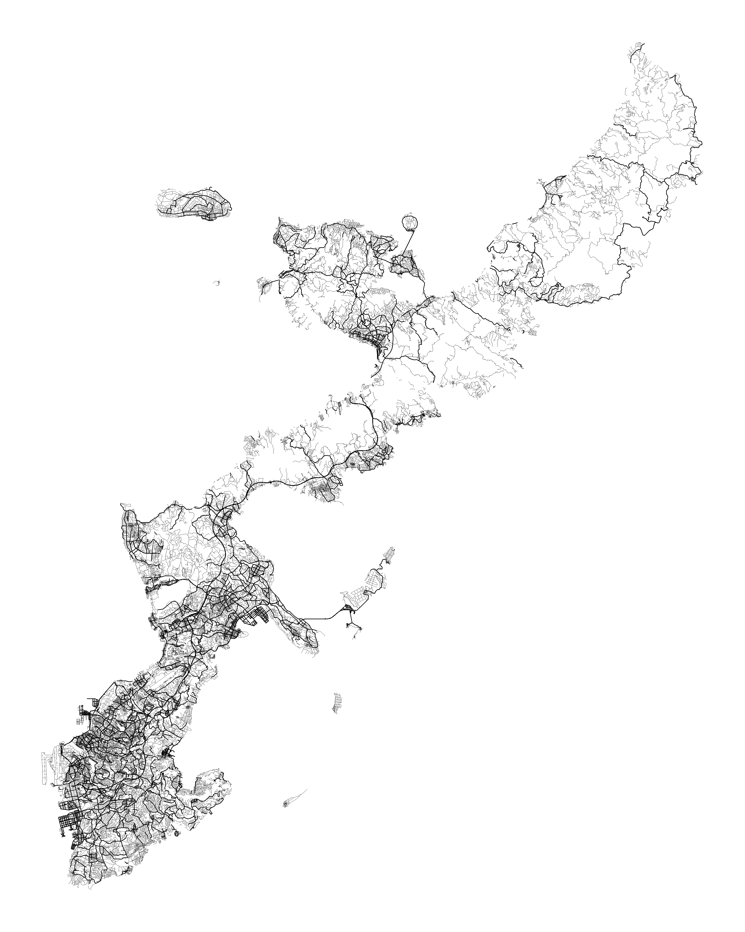
Yambaru
National Park
Ie Island
Nakijin
Motobu
Yagaji
Island
Higashi
Nago
Ginoza
Kin
Uruma
Miyagi
Island
Ginowan
Naha
Airport
Naha
OKINAWA ISLAND
Nanjo
Map made by Alex Elfering
Source: OSM | Inspired by The New York Times

